Slide 1
Detecting
Parkinson’s Disease
Abby Kim, Lisa Li, James Zhang, Srisha Gaur

Slide 2
Table of Contents
01
02
03
Introduction
Motivation
Implementation
04
05
06
Results
Demo
Conclusion

Slide 3
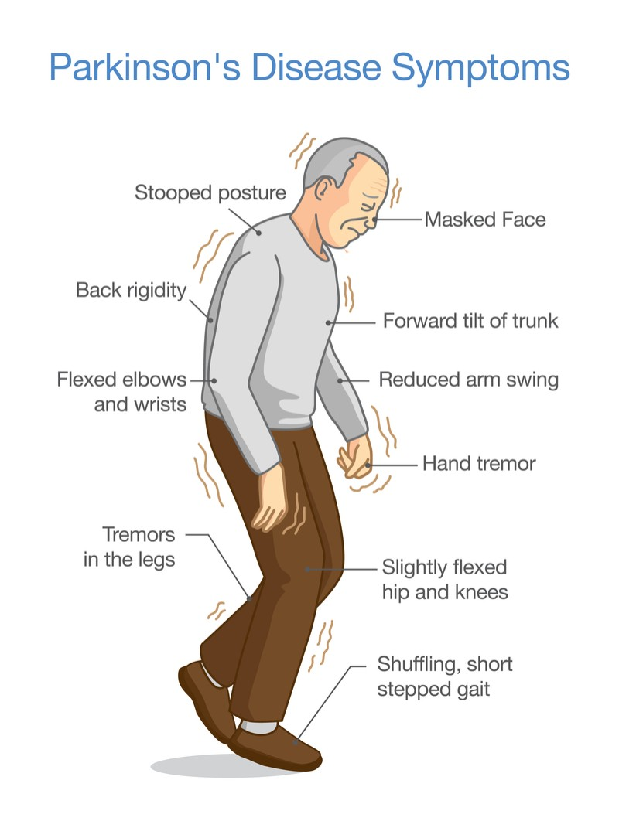
Introduction & Background
Cause unknown
Impacts 1.5 M Americans
Nerve degeneration
Impacts movement
Dopamine production
Responsible for balance
Notes:
Introduction and Background:
Parkinson's Disease is a neurological disorder that affects millions of people worldwide. Typical symptoms of Parkinson’s Disease include uncontrollable tremors, impaired balance and coordination, and rigidity in the muscles

Slide 4
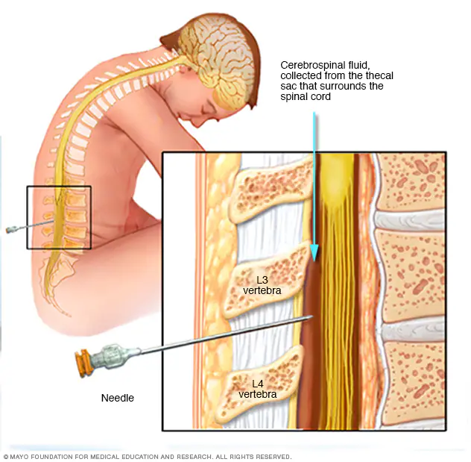
Motivation
Traditional Detection
Invasive procedures
Genetic indicators
Limitations
Costly ( > $1000)
Limited access
Genetic methods are unreliable
Notes:
Current ML Research:
Early detection of the disease can lead to better management and treatment, which is why there is a growing interest in developing accurate and efficient methods for diagnosis. The early diagnosis of Parkinson's Disease is a challenging task, as it involves subtle changes in the patient's motor and cognitive abilities.
Diagnosing Parkinson's disease is subjective and can vary, leading to misdiagnosis or delayed diagnosis. Tests like neuroimaging and genetic testing are costly and not universally available, and a lack of definitive biomarkers makes diagnosis and tracking challenging. According to the United Kingdom National Health Service, "a number of genetic factors have been shown to increase a person's risk of developing Parkinson's disease, although exactly how these make some people more susceptible to the condition is unclear." Current detection methods can't predict disease course or treatment response, hindering personalized treatment planning.

Slide 5
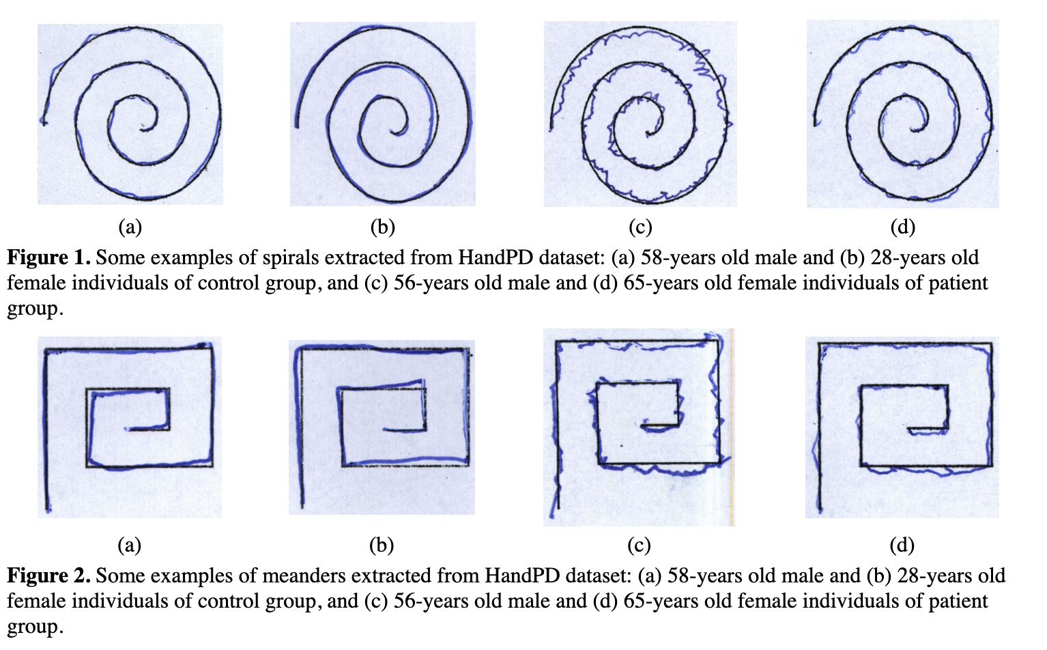
Dataset
Handwritten exams collected at São Paulo State University in Brazil
Notes:
We found a dataset of handwritten exams from two groups of individuals: (i) Healthy Group and (ii) Patient Group, being the latter one composed by individuals affected by Parkinson's Disease (PD).
Meander - we used this (191 images of healthy and confirmed Parkinsons). Circle - not enough data, Spiral - formatting original image was not working

Slide 6


Processed Data
Meander Dataset
Healthy
Parkinson’s
Notes:
So after deciding to use the Meander dataset, we had to process the images for the sake of efficiency. We first resized the images to a uniform size of 224x224 pixels, then converted the image data into a PyTorch Tensor.
The transforms.ToTensor() function was used to convert the image data into a PyTorch tensor. Then we normalized all the tensor values to have a mean of 0.5 and a standard deviation of a 0.5. This is a common technique used in deep learning to help improve the performance of the model. It helps to ensure that the input data has similar statistical properties, which can make it easier for the model to learn the patterns of the data.
So, the final output of these transformations is a tensor with shape (3, 224, 224) that represents the image data, where 3 is the number of color channels (red, green, and blue), and 224x224 is the width and height of the image in pixels.

Slide 7
Implementation
Computer Vision (CV), Convolutional Neural Network (CNN)
Pytorch
Torchvision
Pillow
Sklearn
Notes:
Architecture consists of three convolutional layers, three max pooling layers, and two fully connected layers.
Resized input images to 224 x 224
normalized, converted to PyTorch tensors

Slide 8
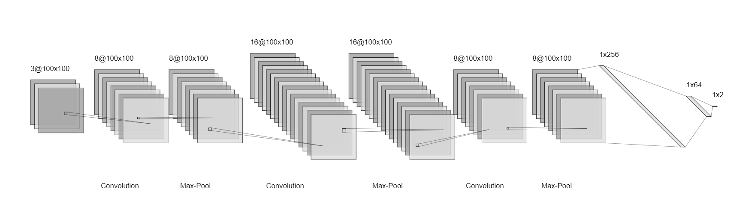
CNN
Convolution
Max-Pool
Convolution
Max-Pool
Convolution
Max-Pool
Notes:
Parkinson's Disease is a neurological disorder that affects millions of people worldwide. Typical symptoms of Parkinson’s Disease include uncontrollable tremors, impaired balance and coordination, and rigidity in the muscles. Early detection of the disease can lead to better management and treatment, which is why there is a growing interest in developing accurate and efficient methods for diagnosis. The early diagnosis of Parkinson's Disease is a challenging task, as it involves subtle changes in the patient's motor and cognitive abilities.
Currently, diagnosing Parkinson's disease relies heavily on genetic indicators, but only 15% of those with Parkinson's have a family history of the disease. Traditional diagnostic methods for Parkinson's involve invasive procedures, such as spinal taps or PET scans, making testing difficult and costly. However, a new project that detects Parkinson's from drawings offers a non-invasive and potentially cost-effective alternative to these methods, making testing more accessible. The project could address the subjectivity of traditional diagnostic approaches, which can lead to misclassification due to subtle movements that are difficult to evaluate. Additionally, early non-motor symptoms of Parkinson's can be mild and overlooked, making early diagnosis a challenge.

Slide 9
Frontend
Frontend
Streamlit
Step-by-step Guidelines
Download & upload images

Slide 10
Deployment
Community Cloud
https://jameszhang2-datathon-home-fh3xz2.streamlit.app/

Slide 11
Demo

Slide 12
Results
Training Accuracy: 90%
Testing Accuracy: 84%
 | Labeled Healthy | Labeled Parkinson’s
Healthy | 95.8% | 4.2%
Has Parkinsons | 16.7% | 83.3%

Slide 13
Conclusion
Convenience, at-home test
Limitations
Requires nice cropping
High false negative rate
Future work
Tune hyper-parameters
More data

Slide 14
Thank You!

